Slide 1

Cacti
Alok Ranjan 2022CSB091 Ranveer Kumar 2022CSB092
Karan Kumar 2022CSB093
Rajesh Kumar 2022CSB094

Slide 2
Purpose

Slide 3
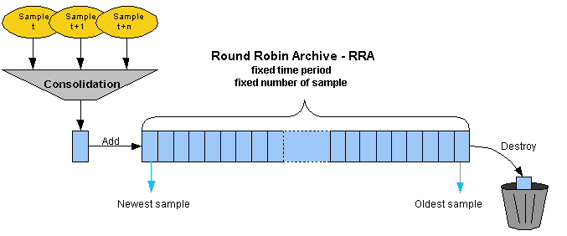
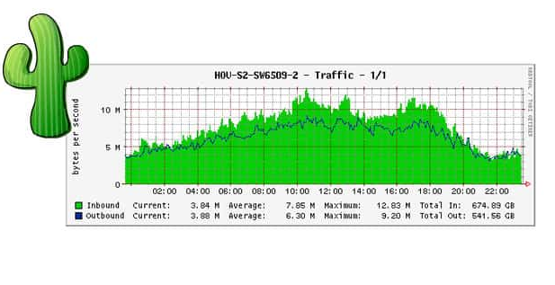
Purpose
Monitor Performance:
Keep track of how well our network and systems are working over time.
Visualize Data
Cacti takes the data it collects and turns it into easy-to-understand graphs.
Manage Faults
Cacti helps you identify problems and faults in your network by setting up alerts and using plugins.
Notes:
Manage Faults example: An IT team sets up Cacti to monitor disk space on a database server. When free space drops below 10%, Cacti automatically sends an email alert to the team. This allows them to clean up unnecessary files before the disk fills completely and causes database failures.

Slide 4

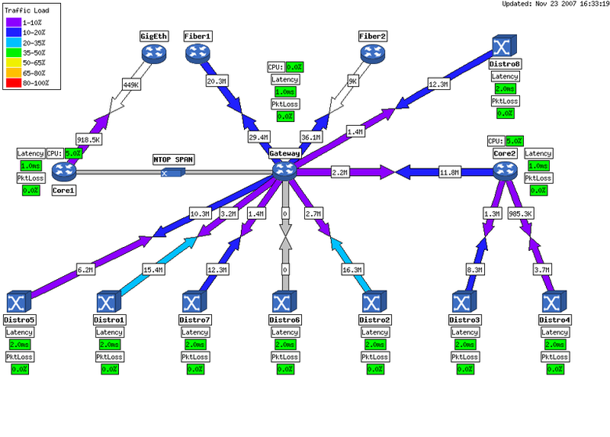
Purpose
Automate Configuration
Simplifies setting up monitoring for your devices using templates and automated discovery. This means you don't have to manually configure each device.
Scale Efficiently
Handles large networks with thousands of devices.
Cacti uses multiple "collectors" to gather data across our network and report back to a central server.
Notes:
Automate Configuration Example: A school needs to monitor 50 identical classroom computers. Instead of configuring each one manually, we can create a single template in Cacti that monitors CPU, memory, and network usage. We apply this template to all computers at once, saving hours of configuration time.
Scale Efficiently Example: A retail chain with 200 stores uses Cacti to monitor all locations. Each store has a small collector that gathers data from local devices (cash registers, Wi-Fi, security cameras). These collectors send summarized data to the central Cacti server, allowing headquarters to monitor the entire operation without overwhelming the network or central server.

Slide 5
Download Path
Source Code : Cacti GitHub Repository
Debian/Ubuntu : apt-get install cacti
RedHat/CentOS/Fedora yum : install cacti or dnf install cacti SUSE Windows Available via Yast or SUSE media Dedicated installer from the official Cacti website
Cacti is available in multiple formats

Slide 6
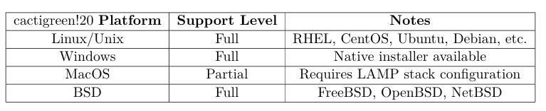
Target Platform

Slide 7
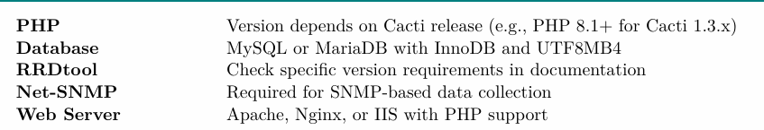
Installation Procedure : System Pre-requirements

Slide 8
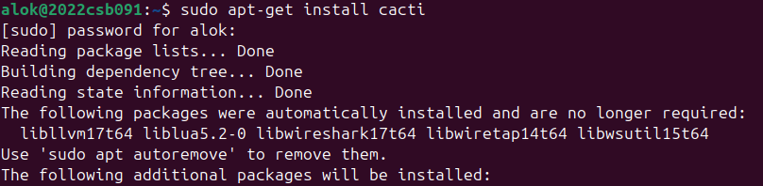
Installation: Ubuntu 24.04 LTS
Available in RPM form and packages for Gentoo, Red Hat, Fedora, SuSE, FreeBSD, etc.
It is necessary to install cacti separately if you wish to use this for larger installations. Again, this code has not been formally measured for improved performance.
In Ubuntu/Debian…
sudo apt-get install cacti

Slide 9
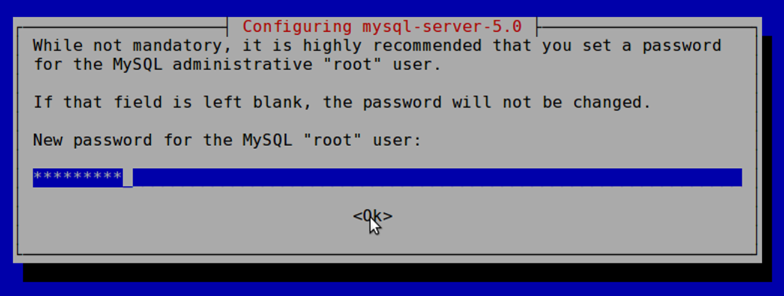
Installation 2
Use the workshop password

Slide 10
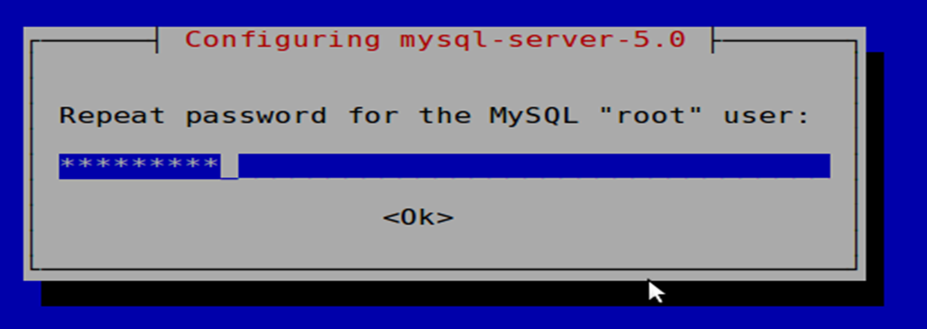
Installation 3
Again, use the workshop password

Slide 11
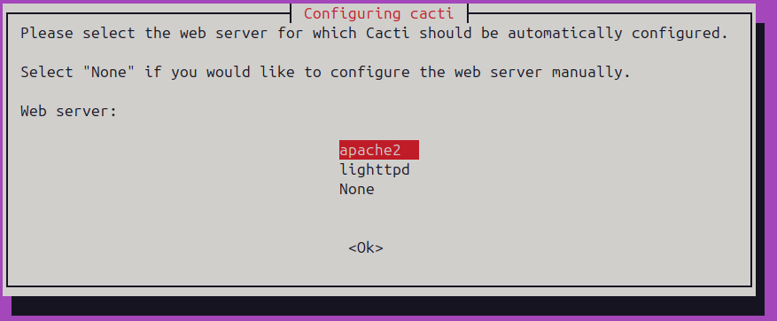
Installation 4
Informational message. Is not normally an issue.

Slide 12
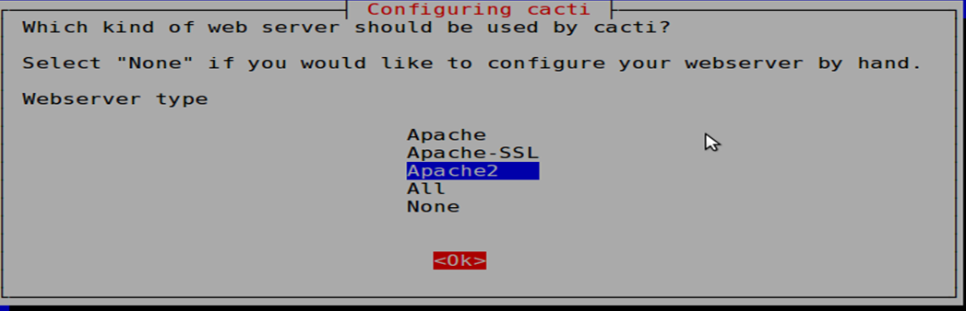
Installation 5
We are using Apache2. Be sure this is chosen, then highlight
<Ok> and press <ENTER> to continue.

Slide 13
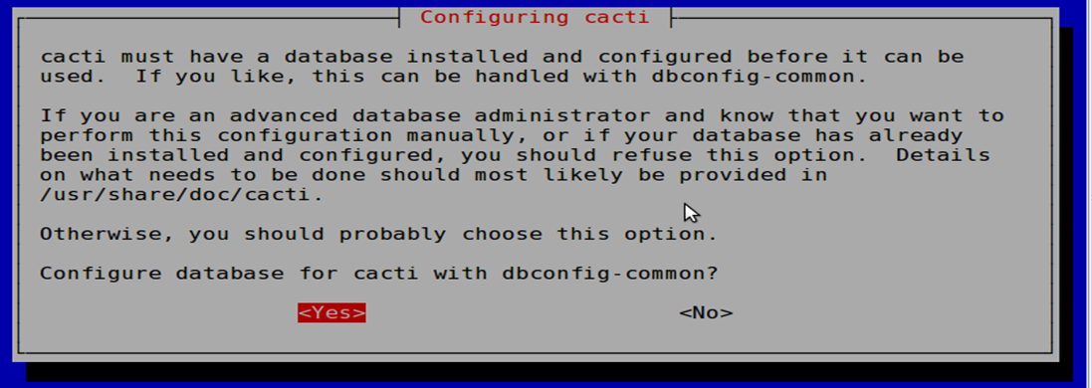

Installation 6

Slide 14
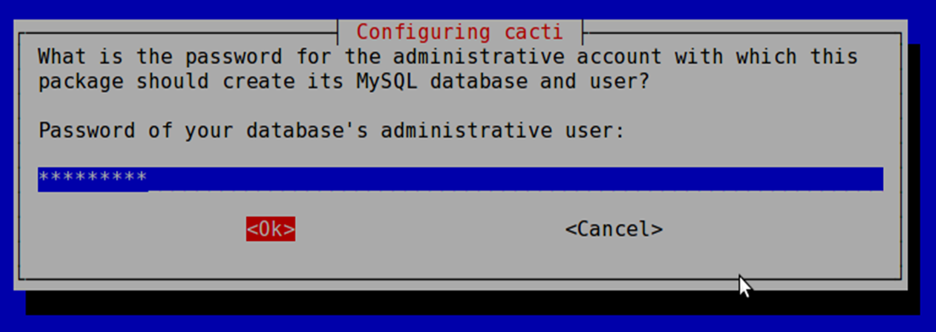
Installation 7

Slide 15
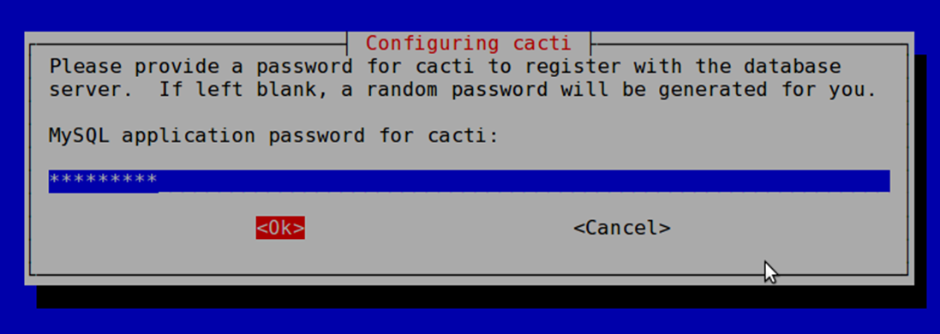
Installation 8

Slide 16
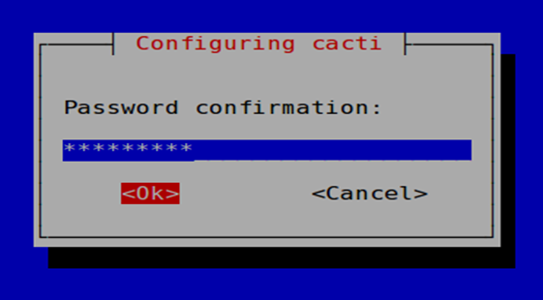
Installation 9
Finally, one last time, use the workshop password.

Slide 17
cacti: Installation
Now use a web browser and open the following address:
http://localhost/cacti
You will see the following...

Slide 18
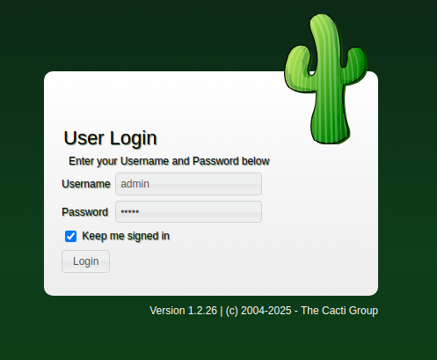
cacti: First Login
First time login use:
User Name: admin
Password : previously entered password

Slide 19
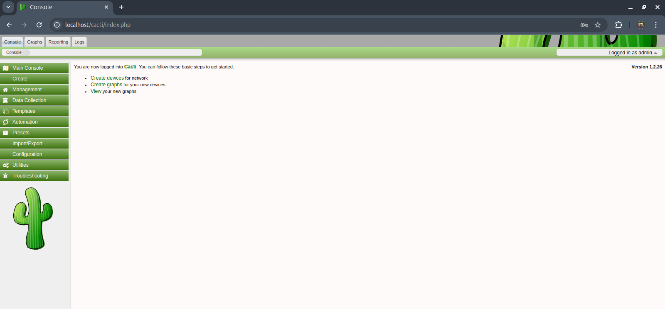
cacti: final page after login

Slide 20
Configuration and Running the Tool
Database Upgrade and Initialization
After installation or when updating, run the database upgrade script
Command : php-q upgrade_database.php--forcever=1.2.22
2. Running the Poller
The poller is the engine that collects data from monitored devices. To run it:
Command : php poller.php

Slide 21
Configuration and Running the Tool
3. Enhanced Data Collection with Spine
For large-scale deployments, the Spine data collector—written in C—offers
significant performance improvements over the default PHP poller by handling
thousands of devices concurrently.
Key advantages include:
Multi-threaded design
Lower CPU and memory utilization
Faster data collection cycles
Better handling of large networks

Slide 22
Configuration and Running the Tool
4. Verify SNMP service
sudo systemctl status snmpd
5. Check Apache and MySQL status sudo systemctl status apache2
sudo systemctl status mysql
Restart Cacti services
sudo systemctl restart apache2 mysql snmp
7. Manually update Cacti poller php /var/www/html/cacti/poller.php

Slide 23
Generating Graphs using cacti
Steps :
Add Devices
Create Graphics
View the Graphics

Slide 24
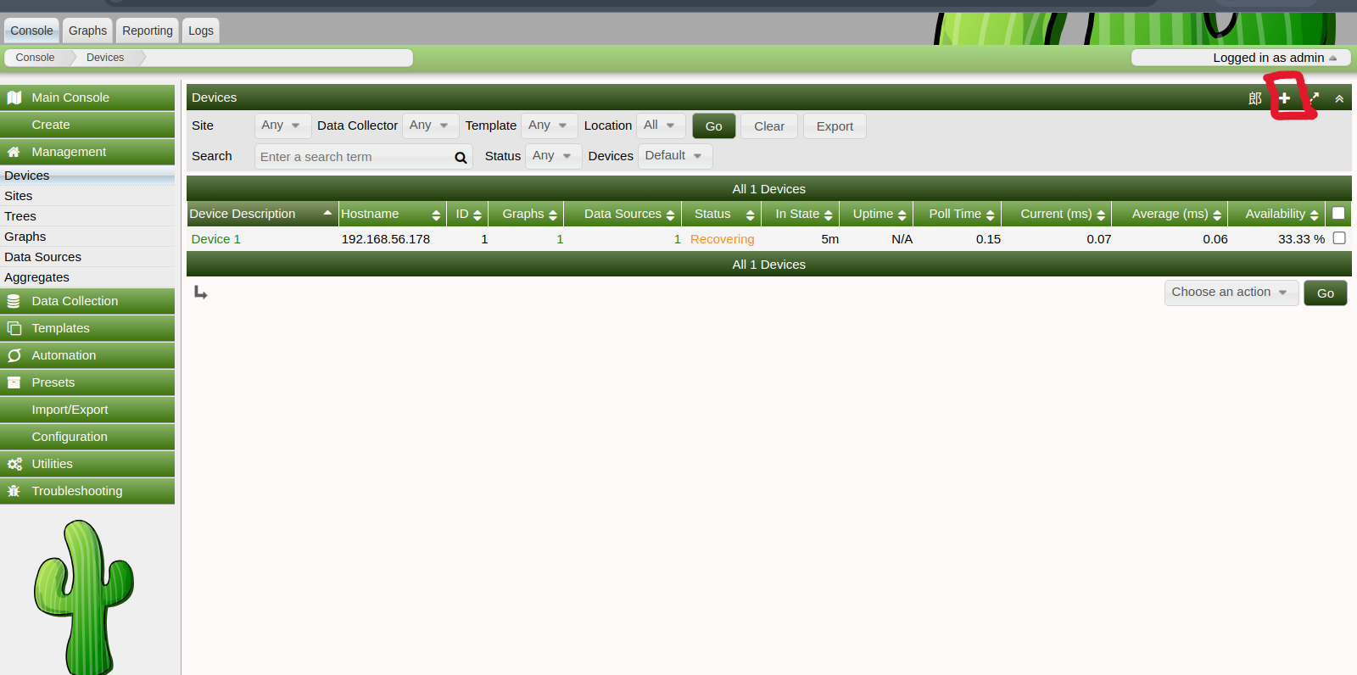
1. Add Devices : 1
Management -> Devices -> Add
Specify device attributes
Choose a device template and this will ask you for additional information about the device.
You can add additional templates when, or if, you want.
Add a Device

Slide 25
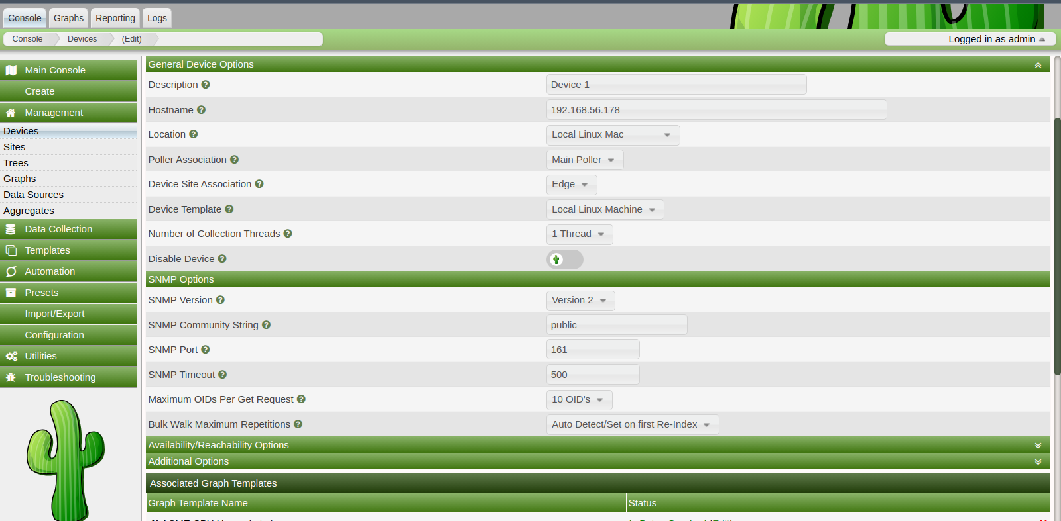
1. Add Devices : 2

Slide 26
1. Add Devices : 3
Choose SNMP version 2 for this workshop.
At your own location you can use SNMP version 3 if your devices support this.
SNMP access is a security issue:
Version 2 is not encrypted
Watch out for globally readable “public” communities
Be careful about who can access r/w communities.

Slide 27
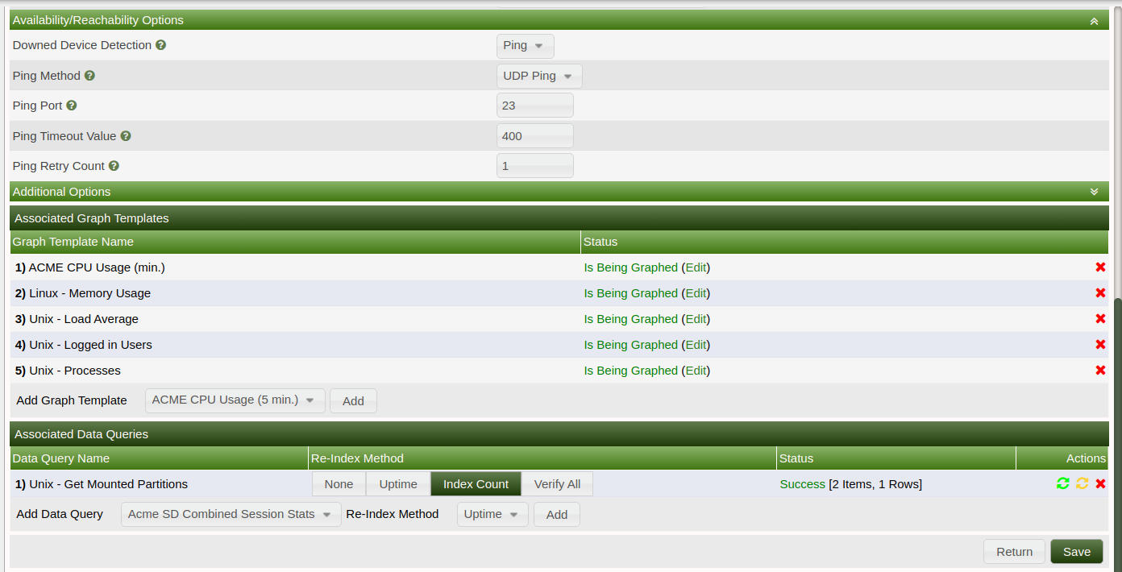
1. Add Devices : 4
Note the “Associated Data Queries” menu: - By default, Cacti does not use SNMP to query a device. You must be sure to add this.

Slide 28
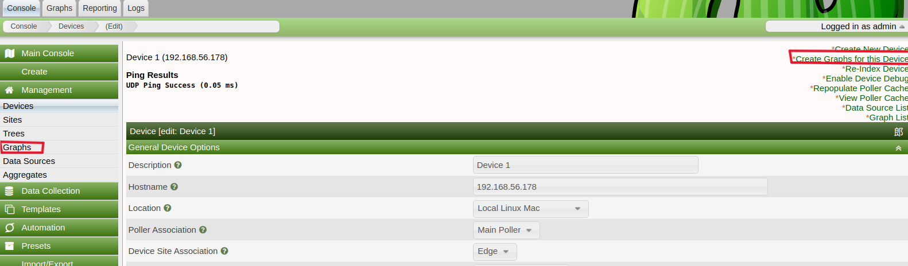
2. Create Graphics : Step 1
Chose the “Create graphs for this host”
Under Graph Templates generally check the top box that chooses all the available graphs to be displayed.
Press Create.
You can change the default colors, but the predefined definitions generally work well.

Slide 29
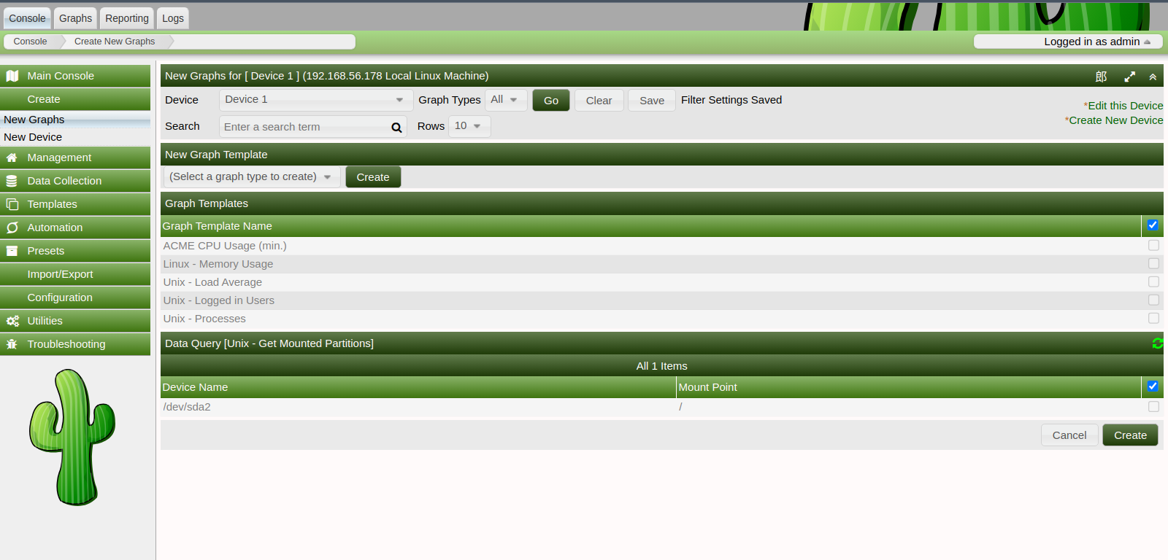
2. Create Graphics : Step 2

Slide 30
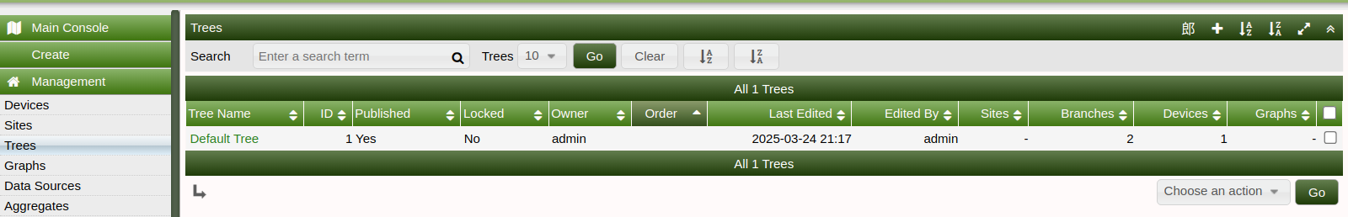
3. View Graphics
Place the new device in its proper location in your tree hierarchy.
Building your display hierarchy is your decision. It might make sense to try drawing this out on paper first.
Under Management → Graph Trees select the Default Tree hierarchy (or, create one of your own).
Default Tree hierarchy⤵️

Slide 31
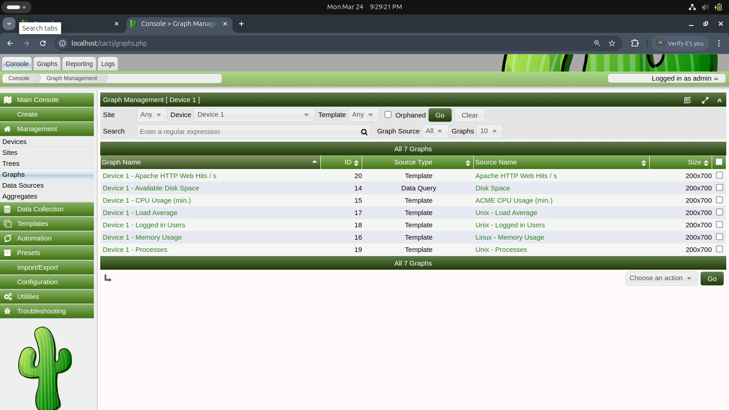
3. View Graphics
To View Graphs :
🏠Management ➡️ Graphs ➡️ Graph Name ➡️ Double Tap to see graph
These are the generated graphs

Slide 32
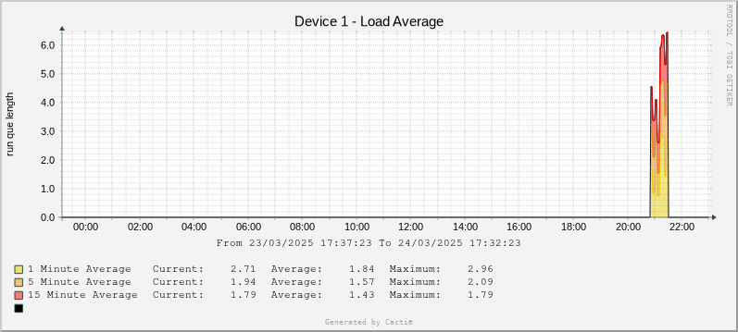
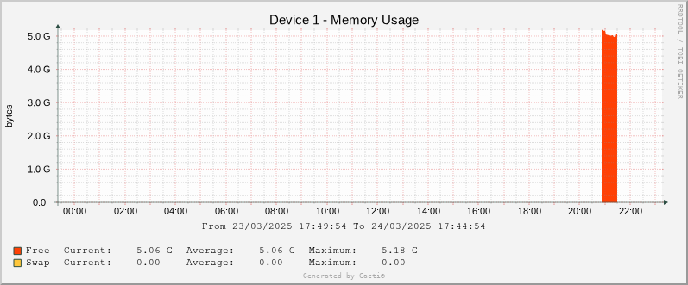
3. View Graphics - Expamples
Load Average Graph
Memory Usage Graph

Slide 33
Case studies

Slide 34
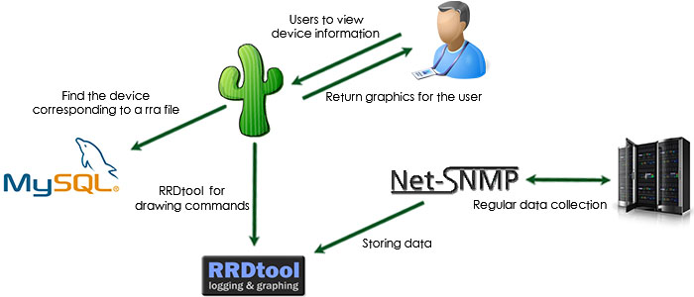
Wireless Network Optimization
A university used Cacti to monitor connected users on wireless access points throughout campus.
How Cacti Monitors Wireless Networks
Cacti can track wireless access point (AP) usage by monitoring the number of connected clients.
This is accomplished through SNMP queries that collect data about client associations.
The data is stored in RRD databases and presented as graphs showing trends over time.
Notes:
SNMP: Simple Network Management Protocol (SNMP) is an Internet Standard protocol used for managing and monitoring network-connected devices in IP networks.

Slide 35
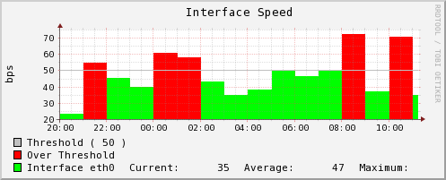
Wireless Network Optimization
Cacti to monitor connected users on wireless access points throughout campus, which enabled them to:
Track User Counts Throughout Day and Year
Identify Peak Load Times and Locations
Plan Strategic Infrastructure Upgrades
Improve Overall Wireless Performance

Slide 36
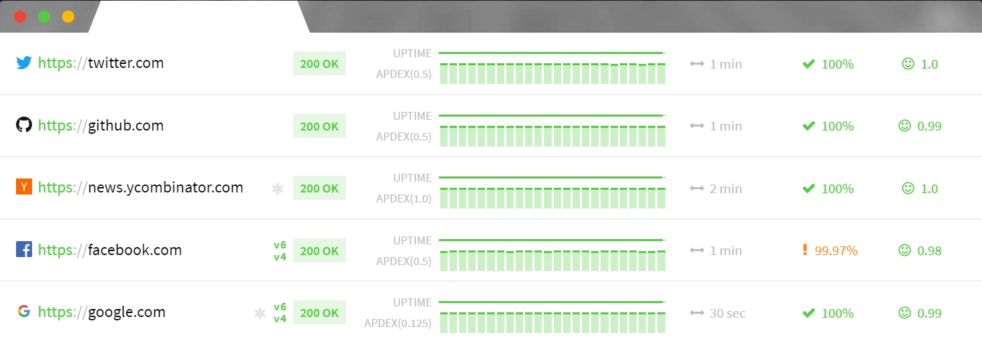

E-commerce Performance Scaling
A growing e-commerce company used Cacti to monitor their server infrastructure. Through analysis of performance metrics such as CPU utilization, memory usage, and network bandwidth, they:
Identified peak usage periods and resource bottlenecks
Accurately forecasted future resource requirements
Proactively upgraded their infrastructure to accommodate increased traffic during seasonal sales
Ensured uninterrupted service and handled increased customer demand

Slide 37
Drawbacks

Slide 38
6. Drawbacks of the Tool
While CACTE is a powerful and effective tool, it does have some drawbacks:
Limited Support for Non-Linux Platforms: Although CACTE can be used on Windows or macOS, the full range of features is optimized for Linux systems. Users on other platforms may face limitations or need additional configuration to fully utilize the tool.
Complex Setup for Beginners: The installation and configuration processes may be challenging for users who are not familiar with network monitoring tools or command-line interfaces. Detailed documentation and user guides are essential for ensuring successful deployment and usage.
Dependency on Network Conditions: CACTE's performance is tied to the network conditions. In highly congested or unstable networks, the tool might experience delayed updates or less accurate reporting.

Slide 39
LIMITED SUPPORT FOR NON LINUX SYSTEM :
Dependency on linux Specific tools and Libraries
Linux based network utilities
Package Management
Performance and Efficiency Differences
Graphical User Interface (GUI) Limitations
Limited Community Support and Documentation for Non-Linux Platforms

Slide 40

Reference
Cacti Github
Cacti Web Site
Cacti Discussion Group
https://www.perplexity.ai/search/cacte-network-monitoring-tool-kl_4XCOjSwanahY.TvnWjw
https://last9.io/blog/essentials-of-snmp-monitoring/

